Slide 1

AntiVirus Software

Slide 2

What is AntiVirus Software?
computer programs intended to identify and eliminate computer viruses.

Slide 3
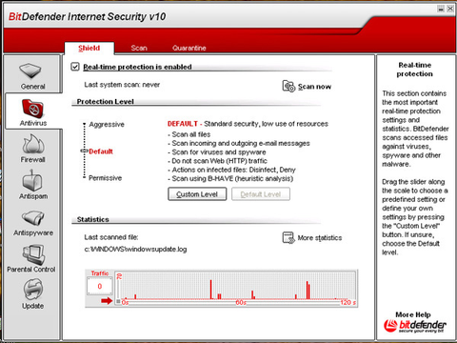
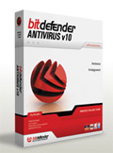
The Best Defense
This years best defense against computer viruses, spyware, hackers and spam is an antivirus program called BitDefender.
It has a user-friendly interface that scans all existing files on your computer, all incoming and outgoing emails.

Slide 4
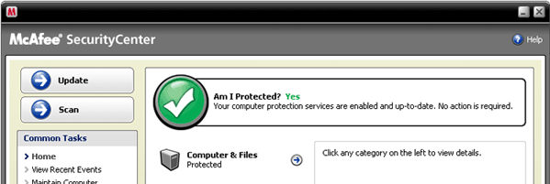
McAfee
McAfee VirusScan is another popular antivirus program.
It’s designed for home and home-office use.
It’s used specifically on a Microsoft Windows platform.
The latest edition includes a number of features including on access file sharing, inbound and outbound firewall protection, and daily definition updates.

Slide 5

Kaspersky
For the average home user and advanced users the Kasperski antivirus software has an easy to use interface.
The program uses 3 tabs for protection, settings and support.
It updates itself on an hourly basis and is one of the fastest antivirus programs available.

Slide 6
“Antivirus software is the equivalent to penicillin of the computer world.”
like penicillin, antivirus applications act as a guard over your system, scanning incoming files and applications, “quarantining” or cleaning up unwanted viruses looking to cause harm to your system
antivirus software is considered to be an aid that detects, fixes and even prevents viruses and worms from spreading to your computer as well as connecting computers.

